Slide 1


SE PROJECT
Introduction to ASL in Virtual Meetings
American Sign Language (ASL) is a powerful tool for enhancing communication and accessibility in virtual meetings. Incorporating ASL into online interactions can create a more inclusive and engaging experience for all participants.
by Anuj Taparia and Ritik Kumar

Slide 2
USING TECHNOLOGY TO IMPROVE ACCESSIBILITY

Slide 3
SIGN LANGUAGE INTERPRETER

Slide 4
REASONS
1 Million Deaf people who use American Sign Language as their primary language.
30 Million Americans hear at 40 decibels (dB) or higher.
“Normal” hearing ranges from 0 to 20 dB.
70 Million Deaf people around the world use sign language
98% of Deaf people this world do not receive education in sign language.
72% of families do not sign with their Deaf children.
70% of Deaf people don’t work or are underemployed.
1 in 4 Deaf people have quit a job due to discrimination.

Slide 5

Benefits of using ASL in Virtual Settings
Improved Engagement
Enhanced Accessibility
Clearer Communication
ASL can help keep remote participants actively involved and attentive during virtual meetings.
ASL provides accessibility for deaf and hard-of-hearing individuals, ensuring equal participation.
Visual cues and hand gestures can often convey meaning more effectively than spoken words alone.

Slide 6




Common ASL Tools for Virtual Communication
Camera
Microphone
Chat
Raise Hand
Indicates the need to turn on or off the camera.
Signals to mute or unmute the microphone.
Expresses the desire to use the chat feature.
Indicates the user wants to speak or ask a question.

Slide 7
Etiquette for using ASL in Virtual Meetings
1
Face the Camera
2
Use Well-Lit Space
Maintain direct eye contact with the camera to ensure clear visibility of your signing.
Ensure your face and hands are well-lit to enhance visibility and expressiveness.
3
Avoid Distractions
4
Provide Captions
Minimize background noise and activity to keep the focus on your ASL communication.
Consider offering closed captioning or transcription services to support attendees.

Slide 8
Accessibility Considerations for ASL Users
Screen Reader Compatibility
ASL Interpreter Provision
Breakout Room Access
Ensure ASL users can seamlessly access and participate in breakout room discussions.
Ensure virtual meeting platforms are compatible with screen readers used by deaf and hard-of-hearing individuals.
Provide professional ASL interpreters to facilitate clear and accurate communication.

Slide 9




Challenges and Solutions for ASL in Virtual Environments
Bandwidth Limitations
Optimize video quality and compression to ensure smooth ASL transmission.
Latency and Lag
Implement strategies to minimize delays and ensure real-time ASL interactions.
Technical Familiarity
Provide training and support to help ASL users navigate virtual meeting platforms.

Slide 10
PROJECT OUTLINE
DATA CREATION
SAMPLE DATA CREATION
DATA PREPARATION
DATA LABELING, DATA FLIPPING
STEPS WE TOOK TO SOLVE THE PROBLEM AND MAKE AN AWESOME MODEL
DEEP LEARNING
CONVOLUTIONAL NEURAL NETWORK
6

Slide 11
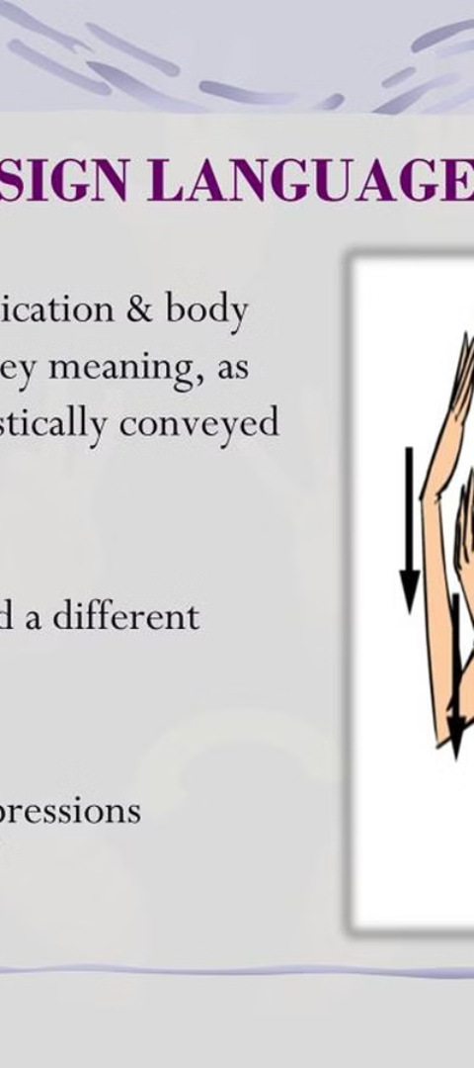
Conclusion and Key Takeaways
Inclusive Communication
Enhancing Engagement
Incorporating ASL into virtual meetings fosters a more inclusive and accessible environment.
ASL can improve participant engagement and foster more effective virtual collaboration.
Overcoming Challenges
By addressing technical and accessibility barriers, organizations can successfully integrate ASL into virtual settings.

Slide 12
THANK YOU
TEAM MEMBERS :-
ANUJ TAPARIA (21MCME09)
RITIK KUMAR (21MCME15)

